Slide 1
Analysis on MLB Pitch Data
Derek Wang and Preston Keskey

Slide 2
Motivation and Goals
Data-driven decision making in MLB presents a competitive edge.
Billy Beane and Moneyball in 2002
Given this, what is the optimal method for MLB teams to analyze/predict pitching data?
Goal 1: Understand the data behind the pitching landscape through EDA and PCA to inform teams/coaches/scouts.
Goal 2: Later, use these insights to develop a predictive model that predicts the next pitch type.
Impact: Inform live at-bat pitch calling, better scouting, better team preparation.

Slide 3
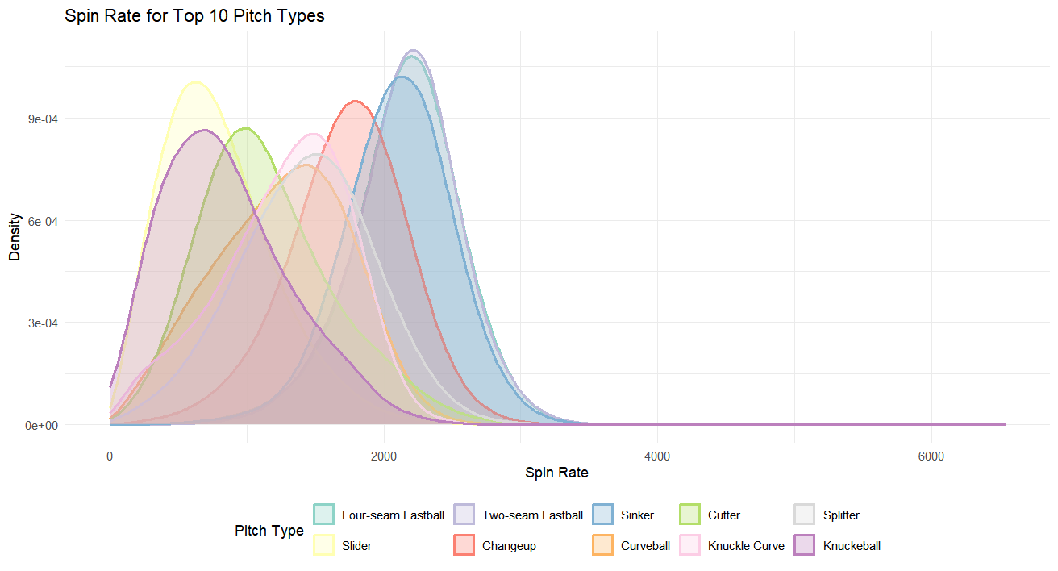
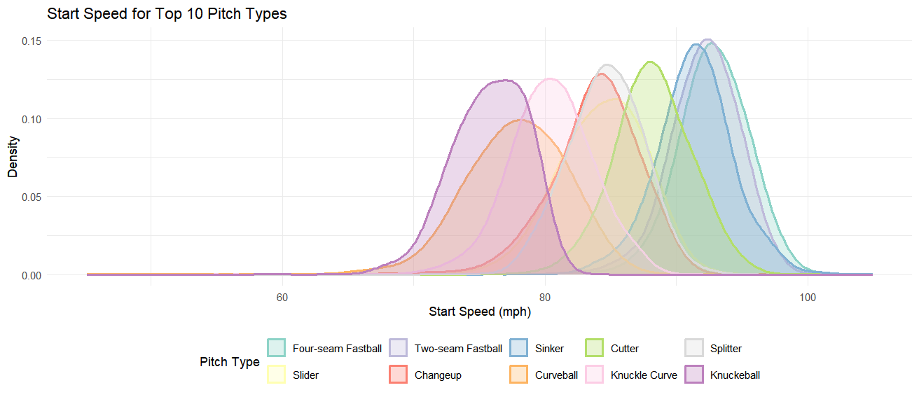
Data Snapshot
Combined 4 separate CSVs by batter, pitcher, game ID.
Now we have at bats and pitch results for every game from 2015 to 2018.
Combined csv has around 2.9 million rows, 67 variables.
Compute missing data through median imputation by pitch type for numerical variables.
Some numerical variables are skewed and heavily differ by pitch type.
Missing data is only <0.01% of total data.

Slide 4
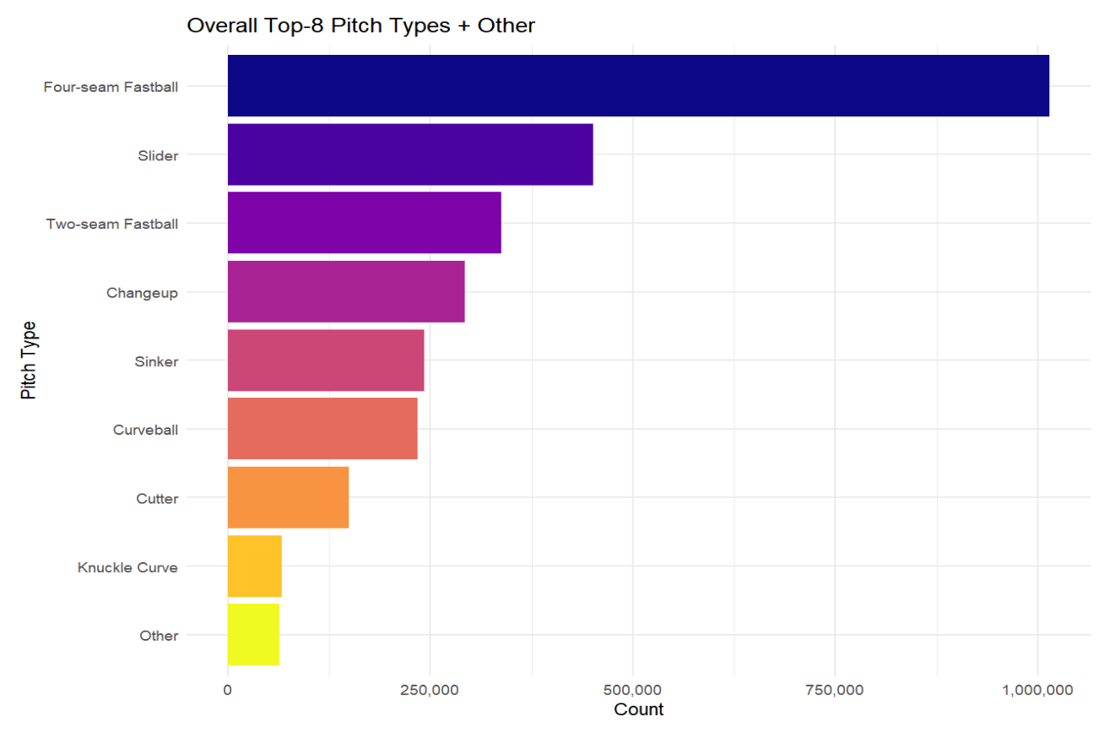
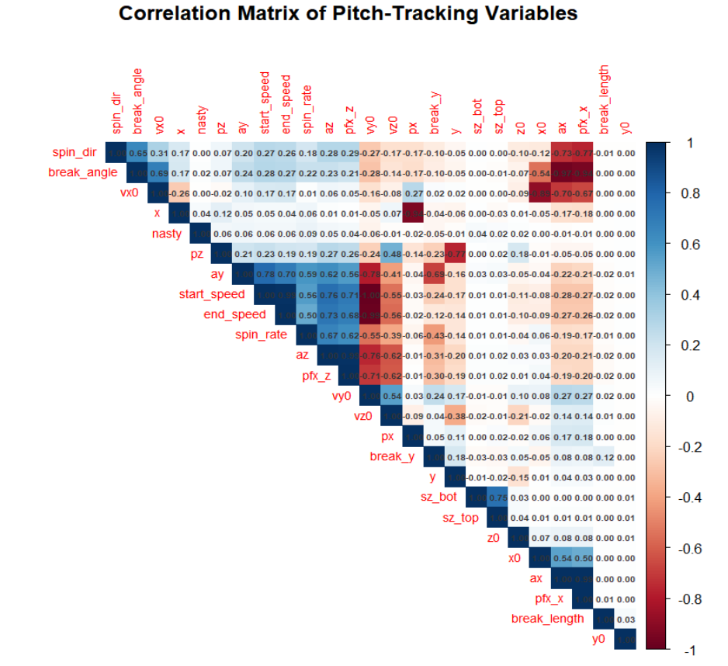
Exploratory Data Analysis
Fastballs dominate pitches in MLB (>60%)
Many off-speed/placement pitches are next in popularity.
Slider, changeup, cutter, curveball
Many velocity metrics exhibit positive correlation between each other.
Back-spin metrics positively correlated with velocity metrics.
Fastballs
Side-spin metrics negatively correlated with velocity metrics.
Sliders, cutters, curveballs, etc.

Slide 5
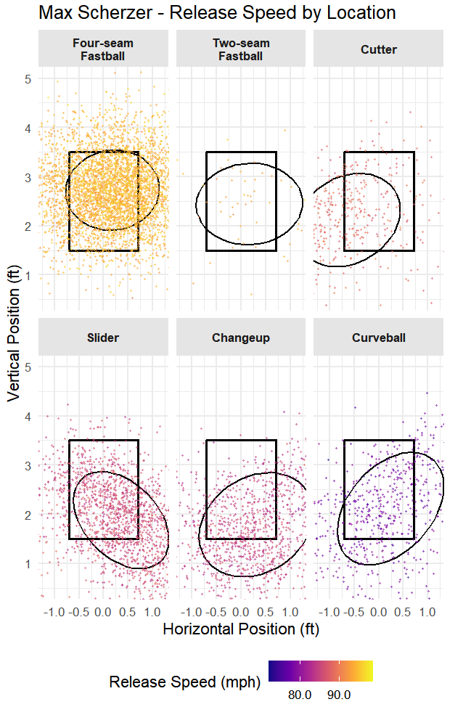
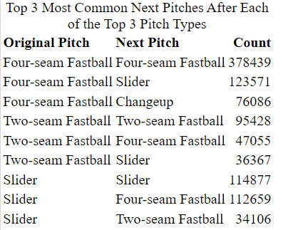
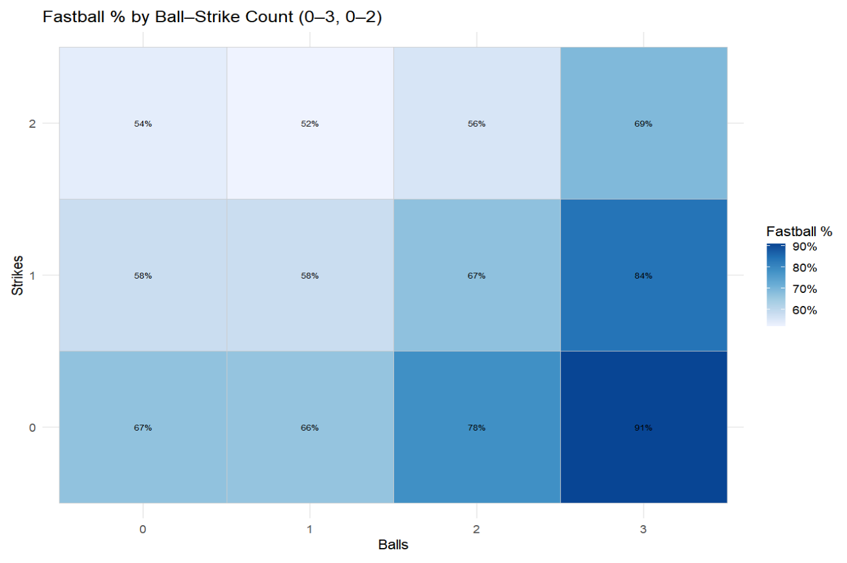
EDA Continued
Exploratory patterns that foreshadow the model:
Table shows pitchers tend to repeat pitch types.
Max Scherzer pitch tendencies/locations based on recreated MLB strike zone from data.
2-0, 3-0, 2-1 are known as “fastball counts” as pitchers want to avoid a walk and get the batter to swing.

Slide 6
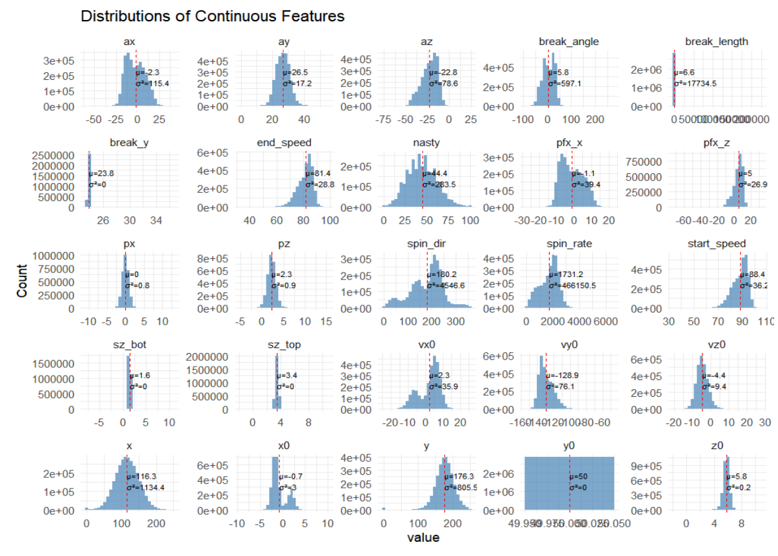
Our Methodological Rationale
PCA collapses the 25 metrics into a few orthogonal axes, making pitch type patterns visible.
The top loadings highlight key variables for certain pitch types that can be used to inform coaches and scouts.
PC scores can be used as inputs in predictive model.
Source variables range have different scales (ft, mph, rpm) and varying distributions.
Scale and center is necessary for PCA.
PCA assumptions are satisfied: no significant outliers, correlation between variables, and a sufficient sample size.

Slide 7
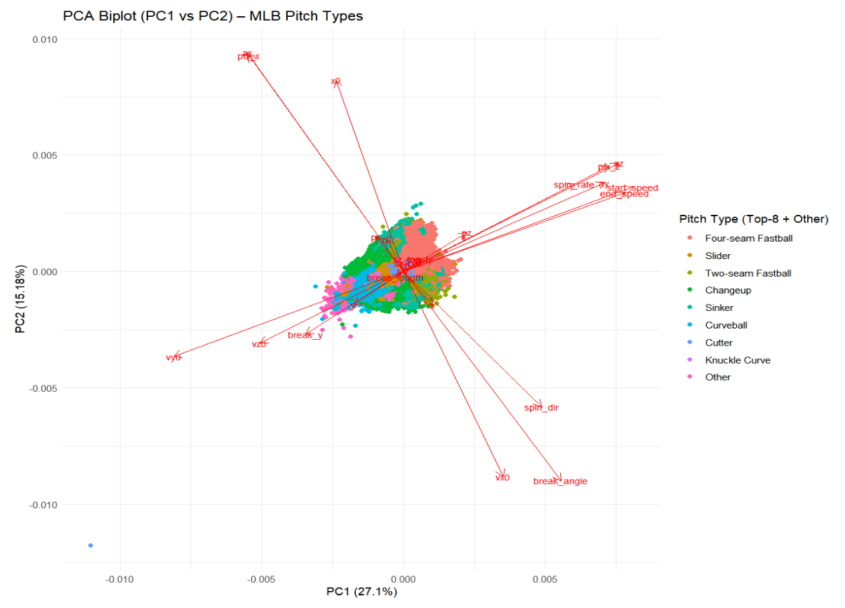
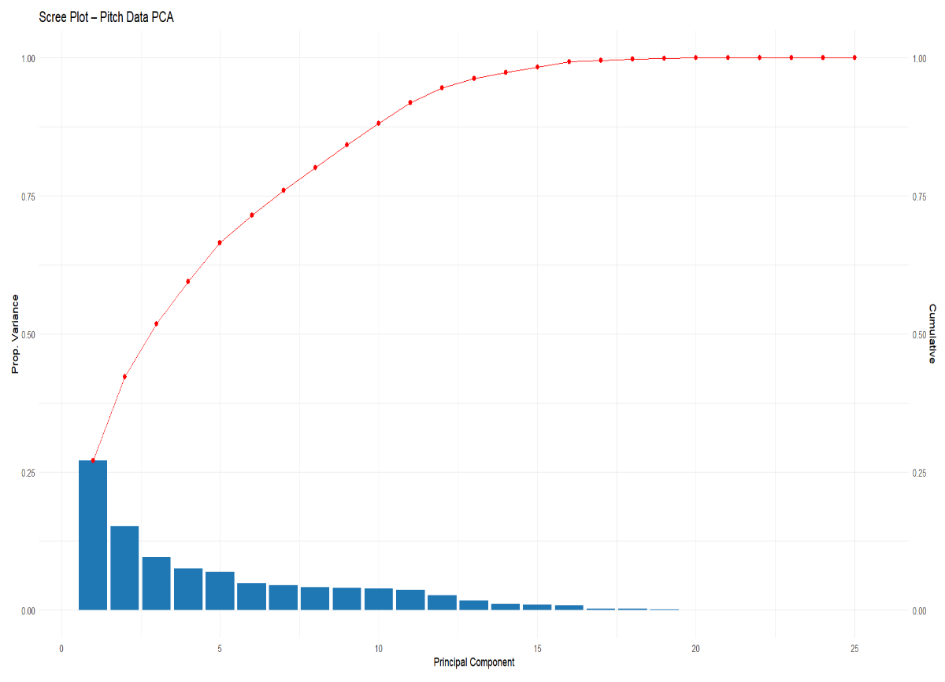
Principal Component Analysis
Keep 8 PCs (80% cumulative variance and elbow on scree plot).
Axes (two distinct pitch types):
PC1: driven by velocity/back-spin variables/verticality (power/ride)
PC2: driven by side-spin/horizontal break/horizontal movement (run/sweep)
Where pitch types cluster
Fastballs cluster positive PC1
High velocity with strong back-spin
Curveballs have negative PC2 and slightly negative PC1
Lower velocity and top-spin
Changeup, sinkers have slightly negative PC2
Moderate velocity with blended spins

Slide 8
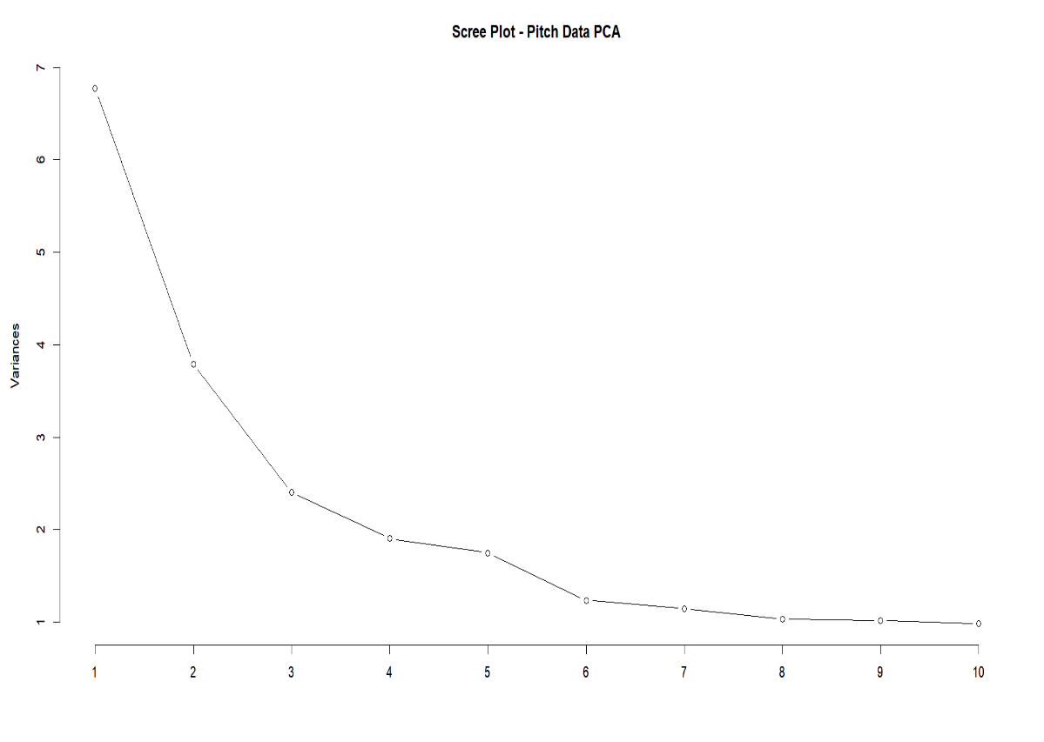
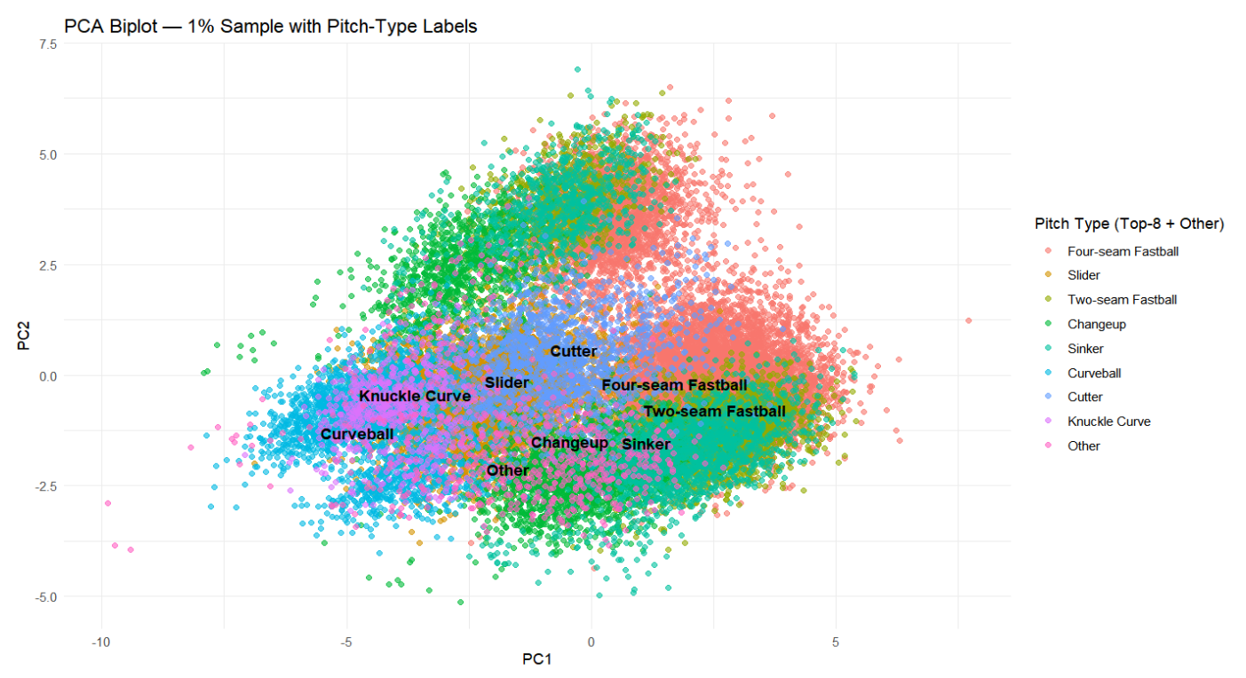
More PCA Plots

Slide 9
Conclusion and Future Work With Predictive Model
Benefits: with PC scores, model/neural network will become faster to train and reduce overfitting
PCA identified several influential variables for certain pitch types that can be used by teams/coaches.
Limitations: possible information/accuracy loss, harder to interpret inputs, only a linear combination of features.
Many neural networks are already known as “black boxes”; using PCA as input could reduce interpretability.
Utilize PC scores and game situation (count, inning, previous pitches, weather, stadium, etc.) as input with pitch type as output.
Hitter/Pitcher parks: Coors Field has higher altitude, leads to more runs, different pitches.
Other ideas to consider: treat pitches as sequential data; utilize RNN/LSTM for better model accuracy.

